Slide 1

COVID-19 Vaccination Verification System
Presented by:
Ritvik Verma
Aston Peter

Slide 2
OUTLINE
01
04
Introduction
Demo
02
05
Technical Information
Background
03
06
QnA
Solution

Slide 3





INTRODUCTION
Living today, with the presence of COVID-19, is quite painful. Processes and tasks which were once simple are now infused with complex procedures, a few examples would be:
Working in Office Spaces
Going to the Hospital
Travelling (Locally or Internationally)
Education
Buying Groceries
Entering Restaurants/Malls

Slide 4



BACKGROUND
Travel Restrictions
Vaccination Bubbles
Quarantine Rules
As International Students we experience these issues faced during overseas travel first hand.
We wanted to come up with a solution that will make moving through the airport much easier.

Slide 5


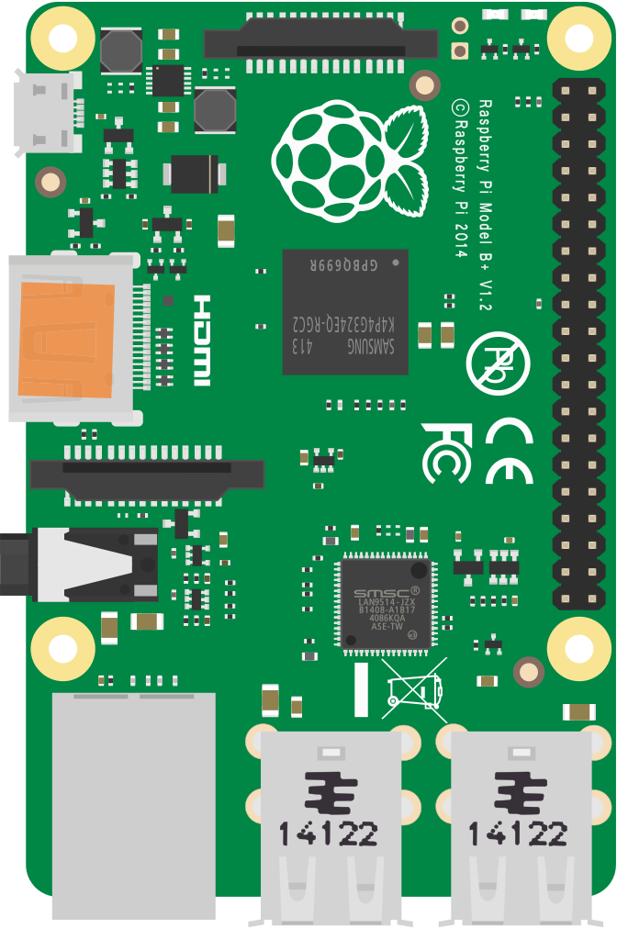

SOLUTION
To implement a system that can verify whether a person has been vaccinated, at the point of entry into a country, with the use of a Raspberry Pi.
At an arrival terminal in the airport, a person will present the system with the necessary documents and will be verified within a few seconds.
Reducing the overall strain on overseas travel.

Slide 6
MAJOR REQUIREMENTS
COMPUTER VISION
RASPBERRY PI
AMAZON WEB SERVICES
AWS Textract is the current tool of choice - can be ported down to Tesseract for non-cloud computing
Simple utilization of OpenCV + Pyzbar for scanning barcodes and displaying text
Affordable and powerful computing for detection systems across various venues

Slide 7
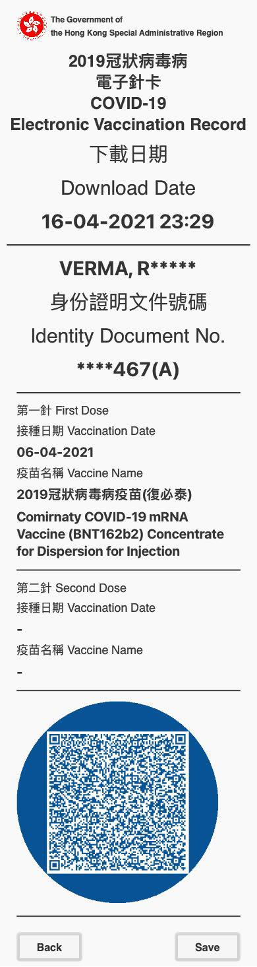
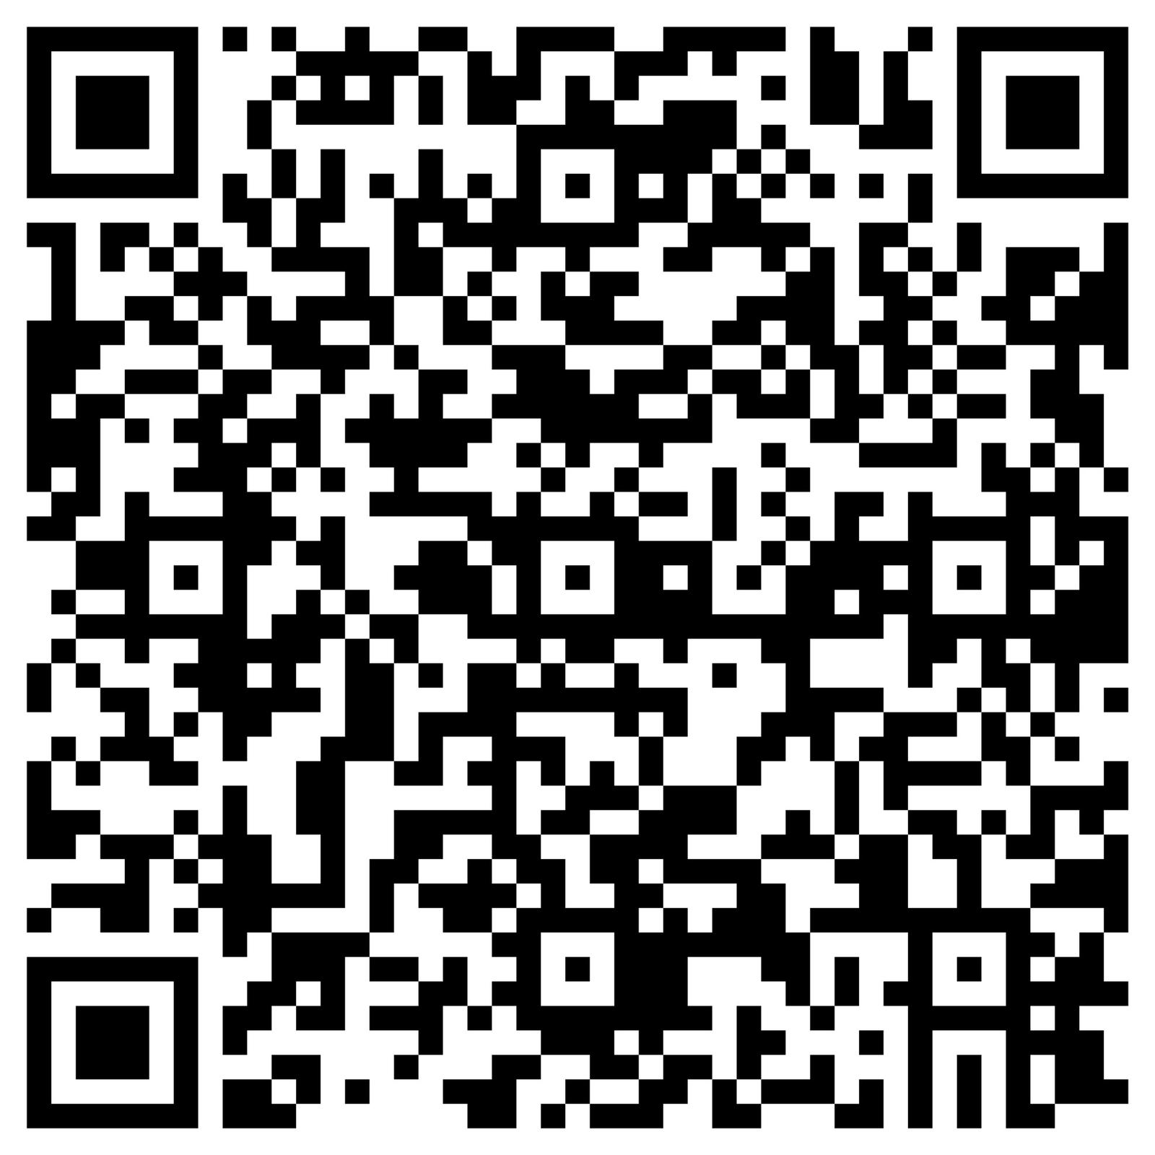
RITVIK’S VACCINATION CERTIFICATE

Slide 8
QR CODE CONTENTS
HKSARG|VAC|3|1|TC21406-492845-7|****467(A)|VERMA, R*****|06-04-2021|Comirnaty COVID-19 mRNA Vaccine (BNT162b2) Concentrate for Dispersion for Injection|<Unique IDs>

Slide 9
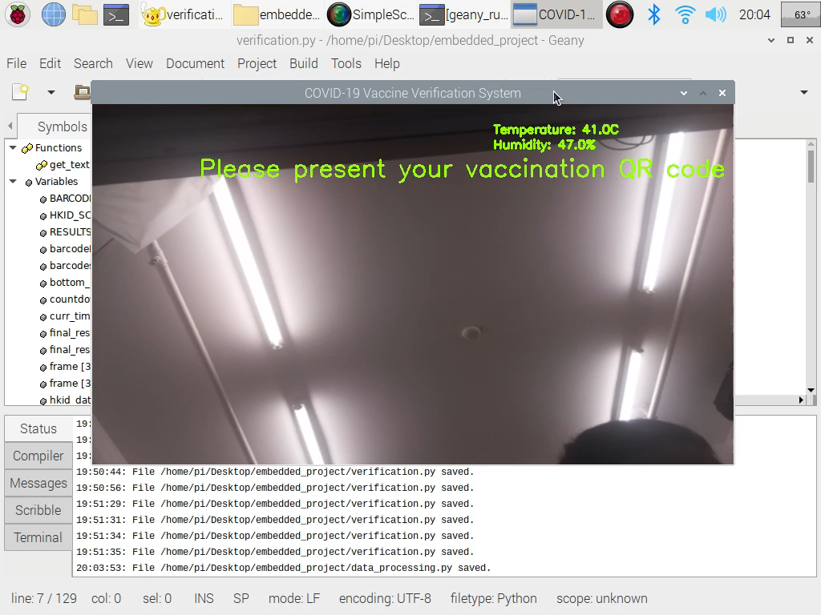
DEMO - Successful Verification

Slide 10
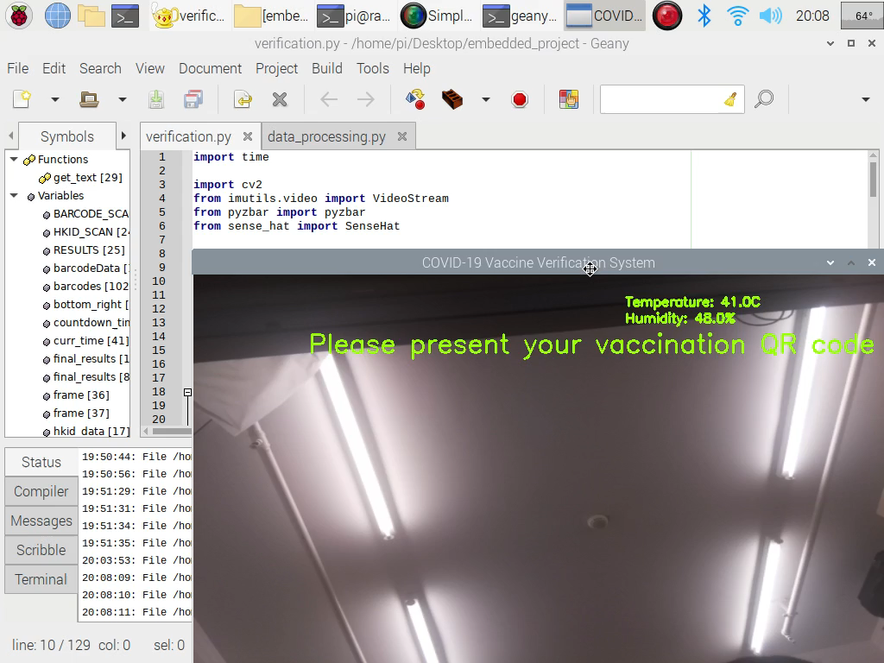
DEMO - Unsuccessful Verification

Slide 11
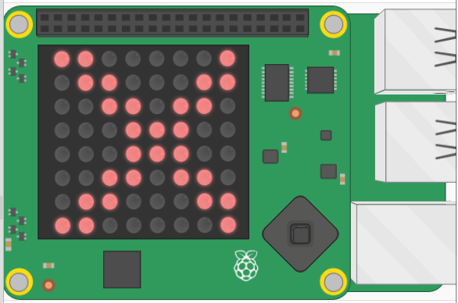
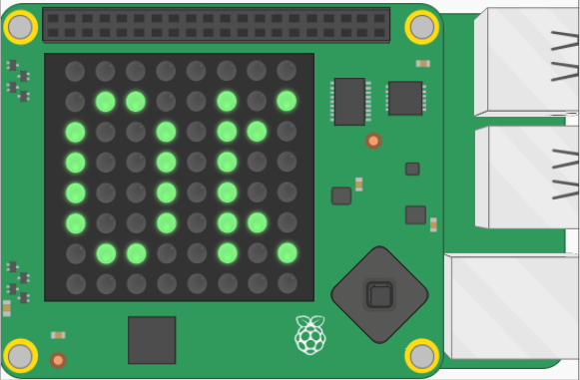
RESULT DISPLAY ON SENSEHAT

Slide 12
TECHNICAL DETAILS
Start
Scan Vaccination Certificate QR Code
Read information off HKID using AWS
Decode and Store Vaccination Information using Pyzbar
Does Information Triangulate?
Scan HKID Card
Verified
Verification Failed.
End

Slide 13

FURTHER IMPROVEMENTS
Application Portability
Improving Security
Specialized Hardware
Link to HKID Database
Notes:
Connection to HKID database

Slide 14
THANKS!
We are now open to questions!

Slide 15
CREDITS
Presentation template by Slidesgo
Icons by Flaticon
Infographics by Freepik
Images created by Freepik
Author introduction slide photo created by Freepik
Text & Image slide photo created by Freepik

